Slide 1

Presentation title, maximum two rows
Reserved space for timer
Space for logo institution of the first author
First Authorª, Second Author^{b}, Third Author^{c},
Fourth Authorª, ...
ª Afiliation of the first author
^{b} Afiliation of the second author
^{c} Afiliation of the third author

Slide 2
Outline
Subsections
...
...
Conclusions
Acknowledgemnts

Slide 3
Subsections
It is preferable to structure the presentation into subsection that are listed on the Outline slide.

Slide 4
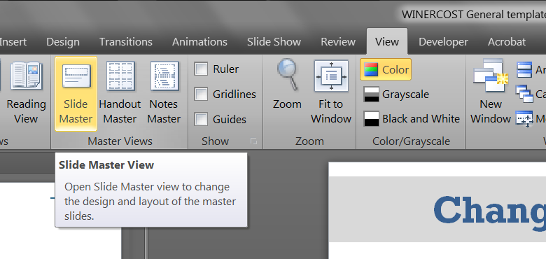
Entering Slide Master
Procedure to change the footer in the master slide is as follows:
  Go to View ribbon section
  Click on the Slide Master icon

Slide 5
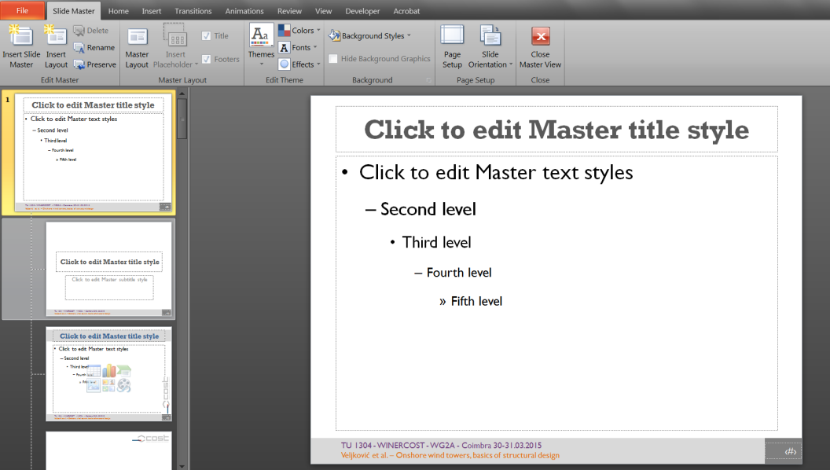
Entering Slide Master
Select the first (root) slide layout!
Enter presentator name and presentation title in footer without changing the style.

Slide 6
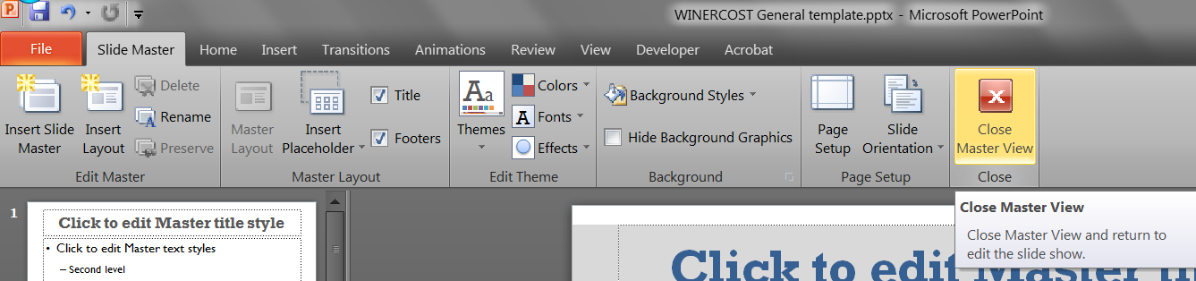
Entering Slide Master
Go back to the Slide Master ribbon section.
Click Close Slide Master.

Slide 7
Conclusion
Conclusions should be concise.
Preferably three to four most important conclusions.
...

Slide 8
Acknowledgements
This slide is optional and can be removed.

